Slide 1
Relations (Equivalence Relations, Ordering)

Slide 2
Equivalence relations:
A relation on a set A is called an equivalence relation if it is reflexive, symmetric, and transitive.
Two elements that are related by an equivalence relation R are called equivalent.
Since R is symmetric, a is equivalent to b whenever b is equivalent to a.
Since R is reflexive, every element is equivalent to itself.
Since R is transitive, if a and b are equivalent and b and c are equivalent, then a and c are equivalent.

Slide 3
Example: Let R be the relation on the set of real numbers such that aRb if and only if a − b is an integer. Is R an equivalence relation?
Solution:
Because a − a = 0 is an integer for all real numbers a, aRa for all real numbers a.Hence, R is reflexive.
Now suppose that aRb. Then a − b is an integer
So b − a is also an integer. Hence, bRa.
It follows that R is symmetric.
If aRb and bRc, then a − b and b − c are integers.
Therefore, a − c = (a − b) + (b − c) is also an integer.
Hence, aRc. Thus, R istransitive.
Consequently, R is an equivalence relation.

Slide 4
Example: Let m be an integer with m > 1. Show that the relation R = {(a, b) | a ≡ b (mod m)} is an equivalence relation on the set of integers.
Solution:
a ≡ b (mod m) if and only if m divides a − b. Now a − a = 0 is divisible by m, Hence, a ≡ a (mod m), so congruence modulo m is reflexive.
Now suppose that a ≡ b (mod m). Then a − b is divisible by m, so a − b = km, where k is an integer. It follows that b − a = (−k)m, so
b ≡ a (mod m). Hence, congruence modulo m is symmetric.
Next, suppose that a ≡ b (mod m) and b ≡ c (mod m). Then m divides both a − b and b − c. Therefore, there are integers k and l with a − b = km and b − c = lm.
Adding these two equations shows that
a − c = (a − b) + (b − c) = km + lm =(k + l)m.
Thus, a ≡ c (mod m). Therefore, congruence modulo m is transitive. It follows that congruence modulo m is an equivalence relation.

Slide 5
Example: Let R be the relation on the set of real numbers such that xRy if and only if x and y are real numbers that differ by less than 1, that is
|x − y| < 1. Show that R is not an equivalence relation.
Solution:
R is reflexive because |x − x| = 0 < 1 whenever x ∈ R.
R is symmetric, for if xRy, where x and y are real numbers, then |x−y| < 1, which tells us that |y − x| = |x − y| < 1, so that yRx.

Slide 6
Transitive???
However, R is not an equivalence relation because it is not transitive. Take x = 2.8, y = 1.9, and z = 1.1,
so that |x − y|=|2.8 −1.9| = 0.9 < 1, |y − z| = |1.9 − 1.1| = 0.8 < 1,
but |x − z| = |2.8 −1.1| = 1.7 > 1.

Slide 7
Equivalence Class:
Let R be an equivalence relation on a set A. The set of all elements that are related to an element a of A is called the equivalence class of a.
The equivalence class of a with respect to R is denoted by [a]_{R}.
When only one relation is under consideration, we will delete the subscript R and write [a] for this equivalence class.
If b∈[a]_{R}, b is called a representative of this equivalence class.

Slide 8
Example: What are the equivalence classes of 0 and 1 for congruence modulo 4?
Solution:
The equivalence class of 0 contains all integers a such that a ≡ 0 (mod 4). The integers in this class are those divisible by 4.
Hence, the equivalence class of 0 for this relation is [0] = {. . . , −8, −4, 0, 4, 8, . . . }.
The equivalence class of 1 contains all the integers a such that a ≡ 1 (mod 4). The integers in this class are those that have a remainder of 1 when divided by 4.
Hence, the equivalence class of 1 for this relation is [1] = {. . . , −7, −3, 1, 5, 9, . . . }.

Slide 9
Theorem: Let R be an equivalence relation on a set A. The following statements are equivalent:
aRb
[a] = [b]
[a] ∩ [b] ≠ ∅
Partition of a set: A partition of a set S is a collection of disjoint nonempty subsets of S that have S as their union. In other words, the collection of subsets A_{i}, i∈I, forms a partition of S if and only if
(i) A_{i} ≠ ∅ for i∈I
(ii) A_{i} ∩ A_{j} = ∅, if i ≠ j
(iii) ∪_{i∈I} A_{i} = S

Slide 10
Examples: Let S be the set {u, m, b, r, o, c, k, s}. Do the following collections of sets partition S ?
Solution:
{{m, o, c, k}, {r, u, b, s}}
{{c, o, m, b}, {u, s}, {r}}
{{b, r, o, c, k}, {m, u, s, t}}
{{u, m, b, r, o, c, k, s}}
{{b, o, r, k}, {r, u, m}, {c, s}}
{{u, m, b}, {r, o, c, k, s}, Ø}
yes.
no (k is missing).
no (t is not in S).
yes.
No (r is in two sets)
no (∅ not allowed).

Slide 11
Theorem: Let R be an equivalence relation on a set S. Then the equivalence classes of R form a partition of S. Conversely, given a partition {A_{i} | i∈I} of the set S, there is an equivalence relation R that has the sets A_{i}, i∈I, as its equivalence classes.
Example: What are the sets in the partition of the integers arising from congruence modulo 4?
Solution:
There are four congruence classes, corresponding to [0]4, [1]4, [2]4, and [3]4. They are the sets
[0]4 = {. . . , −8, −4, 0, 4, 8, . . . },
[1]4 = {. . . , −7, −3, 1, 5, 9, . . . },
[2]4 = {. . . , −6, −2, 2, 6, 10, . . . },
[3]4 = {. . . , −5, −1, 3, 7, 11, . . . }.

Slide 12
Partial Ordering:
A relation R on a set S is called a partial ordering or partial order if it is reflexive, antisymmetric, and transitive.
A set S together with a partial ordering R is called a partially ordered set, or poset, and is denoted by (S, R).

Slide 13
Example: Consider the “greater than or equal” relation ≥ (defined by {(a, b) | a ≥ b}).Is ≥ a partial ordering on the set of integers?
Solution:
≥ is reflexive, because a ≥ a for every integer a.
≥ is antisymmetric, because if a ≠ b, then a ≥ b ∧ b ≥ a is false.
≥ is transitive, because if a ≥ b and b ≥ c, then a ≥ c.
Consequently, (Z, ≥) is a partially ordered set.

Slide 14
Example: Is the “inclusion relation” ⊆ a partial ordering on the power set of a set S?
Solution:
⊆ is reflexive, because A ⊆ A for every set A.
⊆ is antisymmetric, because if A ≠ B, then A ⊆ B ∧ B ⊆ A is false.
⊆ is transitive, because if A ⊆ B and B ⊆ C, then A ⊆ C.
Consequently, (P(S), ⊆) is a partially ordered set.

Slide 15

The symbol is used to denote the relation in any poset
Definition:
Example: In the poset (Z⁺, |), are the integers 3 and 9 comparable? Are 5 and 7 comparable?
Solution:
The integers 3 and 9 are comparable, because 3 | 9. The integers 5 and 7 are incomparable, because 5 | 7 and 7 | 5
Definition:

Slide 16
Example : Is (Z, ≤) a totally ordered poset?
Solution:
Yes, because a ≤ b or b ≤ a for all integers a and b.
Example : Is (Z⁺, |) a totally ordered poset?
Solution:
No, because it contains incomparable elements such as 5 and 7.

Slide 17
Hasse Diagrams
Like relations and functions, partial orders have a convenient graphical representation: Hasse Diagrams
Consider the digraph representation of a partial order
Because we are dealing with a partial order, we know that the relation must be reflexive and transitive
Thus, we can simplify the graph as follows
Remove all self loops
Remove all transitive edges
Remove directions on edges assuming that they are oriented upwards
The resulting diagram is far simpler

Slide 18
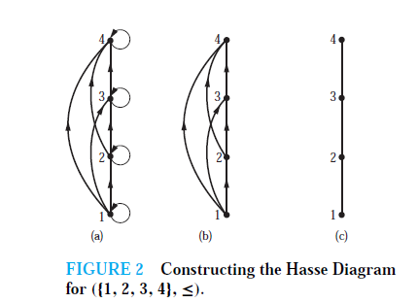
Hasse Diagram
Many edges in the directed graph for a finite poset do not have to be shown because they must be present.

Slide 19
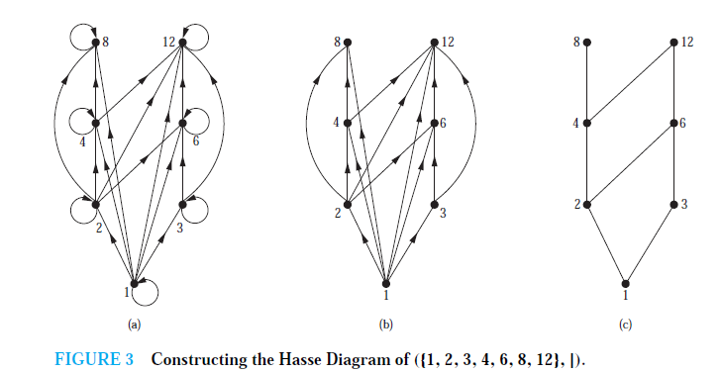
Ex2: Draw the Hasse diagram representing the partial ordering {(a, b) |a divides b} on {1, 2, 3, 4, 6, 8, 12}.

Slide 20
Ex3: Draw the Hasse diagram for the partial ordering {(A,B) | A ⊆ B} on the power set P(S) where S = {a, b, c}.
Solution: The Hasse diagram for this partial ordering is obtained from the associated digraph by
deleting all the loops and all the edges that occur from transitivity, namely,
(∅, {a, b}), (∅, {a, c}),(∅, {b, c}), (∅, {a, b, c}), ({a}, {a, b, c}), ({b}, {a, b, c}), and ({c}, {a, b, c}).
Finally all edges point upward, and arrows are deleted.

Slide 21
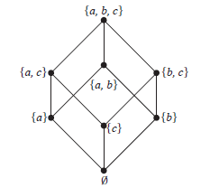

Slide 22
Extremal Elements: Summary
We will define the following terms:
A maximal/minimal element in a poset (S, p)
The maximum (greatest)/minimum (least) element of a poset (S, p)
An upper/lower bound element of a subset A of a poset (S, p)
The greatest lower/least upper bound element of a subset A of a poset (S, p)

Slide 23
Extremal Elements: Maximal
Definition: An element a in a poset (S, p) is called maximal if it is not less than any other element in S. That is: ¬(∃b∈S (apb))
If there is one unique maximal element a, we call it the maximum element (or the greatest element)

Slide 24
Extremal Elements: Minimal
Definition: An element a in a poset (S, p) is called minimal if it is not greater than any other element in S. That is: ¬(∃b∈S (bpa))
If there is one unique minimal element a, we call it the minimum element (or the least element)

Slide 25
Extremal Elements: Upper Bound
Definition: Let (S,p) be a poset and let A⊆S. If u is an element of S such that a p u for all a∈A then u is an upper bound of A
An element x that is an upper bound on a subset A and is less than all other upper bounds on A is called the least upper bound on A. We abbreviate it as lub.

Slide 26
Extremal Elements: Lower Bound
Definition: Let (S,p) be a poset and let A⊆S. If l is an element of S such that l p a for all a∈A then l is an lower bound of A
An element x that is a lower bound on a subset A and is greater than all other lower bounds on A is called the greatest lower bound on A. We abbreviate it glb.

Slide 27
Extremal Elements: Example 1
c
d
a
b
What are the minimal, maximal, minimum, maximum elements?
Minimal: {a,b}
Maximal: {c,d}
There are no unique minimal or maximal elements, thus no minimum or maximum

Slide 28
Extremal Elements: Example 2
Give lower/upper bounds & glb/lub of the sets:
{d,e,f}, {a,c} and {b,d}
{d,e,f}
Lower bounds: ∅, thus no glb
Upper bounds: ∅, thus no lub
{a,c}
g
h
i
Lower bounds: ∅, thus no glb
Upper bounds: {h}, lub: h
d
e
f
{b,d}
Lower bounds: {b}, glb: b
a
b
c
Upper bounds: {d,g}, lub: d because dpg

Slide 29
Extremal Elements: Example 3
Minimal/Maximal elements?
i
j
Minimal & Minimum element: a
Maximal elements: b,d,i,j
f
g
h
Bounds, glb, lub of {c,e}?
Lower bounds: {a,c}, thus glb is c
Upper bounds: {e,f,g,h,i,j}, thus lub is e
e
b
c
d
Bounds, glb, lub of {b,i}?
Lower bounds: {a}, thus glb is c
Upper bounds: ∅, thus lub DNE
a

Slide 30
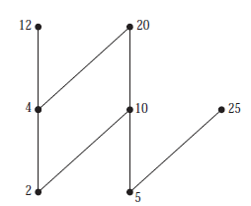
Ex4: Which elements of the poset ({2, 4, 5, 10, 12, 20, 25}, |) are maximal, and which are minimal?

Slide 31
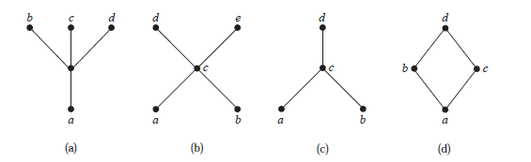
Ex 5: Determine whether the posets represented by each of the Hasse diagrams have a greatest element and a least element.

Slide 32
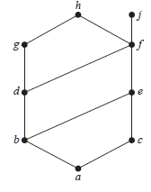
Ex: Find the lower and upper bounds of the subsets {a, b, c}, {j, h}, and {a, c, d, f } in the poset with the Hasse diagram shown in Figure.
Find the greatest lower bound and the least upper bound of {b, d, g}, if they exist, in the poset shown in Figure .

Slide 33
Lattices
A special structure arises when every pair of elements in a poset has an lub and a glb
Definition: A lattice is a partially ordered set in which every pair of elements has both
a least upper bound and
a greatest lower bound

Slide 34
Lattices: Example 1
Is the example from before a lattice?
i
j
f
g
h
No, because the pair {b,c} does not have a least upper bound
e
b
c
d
a

Slide 35
Lattices: Example 2
What if we modified it as shown here?
j
i
f
g
h
Yes, because for any pair, there is an lub & a glb
e
b
c
d
a

Slide 36
A Lattice Or Not a Lattice?
To show that a partial order is not a lattice, it suffices to find a pair that does not have an lub or a glb (i.e., a counter-example)
For a pair not to have an lub/glb, the elements of the pair must first be incomparable (Why?)
You can then view the upper/lower bounds on a pair as a sub-Hasse diagram: If there is no minimum element in this sub-diagram, then it is not a lattice

Slide 37
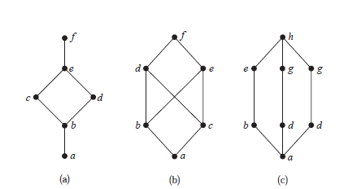
Lattices
A partially ordered set in which every pair of elements has both a least upper bound and a greatest lower bound is called a lattice.
Ex: Determine whether the posets represented by each of the Hasse diagrams in Figure are lattices.

